Slide 1
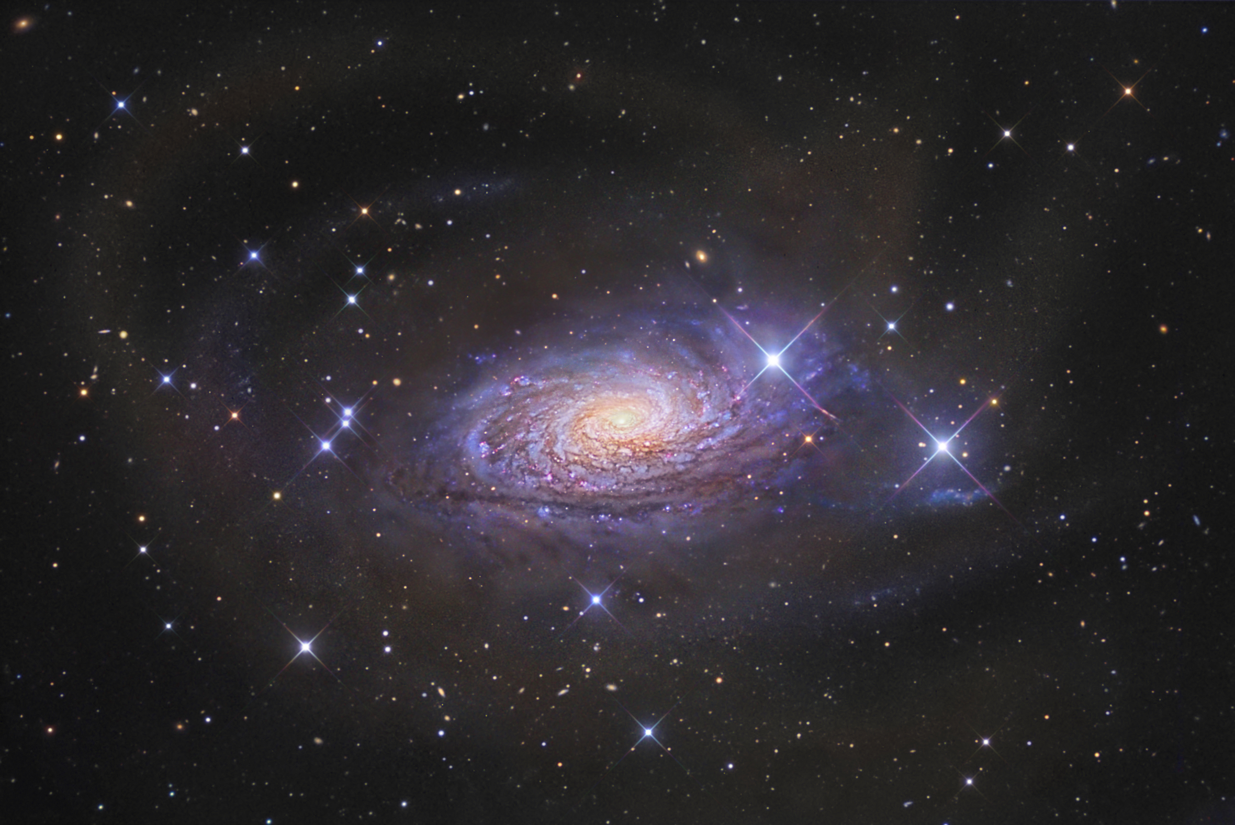
PHAS0004
(Atoms), STARS and THE UNIVERSE
Prof. Ofer Lahav

Slide 2
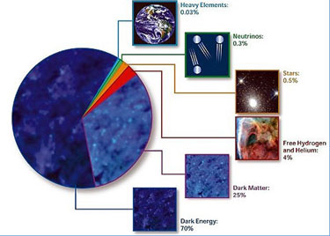
What is the present Universe made of?
Dark Energy 70%
Atoms 5%
Cold Dark Matter 25%

Slide 3
PHAS0004 – Part TWO
Stellar Astrophysics
2) Galaxies and Cosmology
• 3 hours of lectures per week (as normal)
Mon. 11:00-13:00
Wed. 10:00 - 11:00
+ ‘Problem solving tutorials’ → online timetable

Slide 4
Aims of the course
To introduce (in 5 weeks) key concepts in Astrophysics and Cosmology
To approach the frontiers of understanding in
stellar Astrophysics and in Cosmology.
To provide a basis of descriptive knowledge for course choices in later years.
No previous knowledge of Astrophysics assumed!

Slide 5
Notes – Partial lectures PDF slides on moodle
(download them!)
BUT
there’ll be additional material during the lectures!
and occasional links to extra reading.
Astrophysics ICA in December (based on PSTs)

Slide 6
PHAS0004 -- Astrophysics
Topics covered
Radiation, luminosity, effective temperature
Stellar spectra and classification of stars
Stellar evolution
Galaxies and large-scale structure in the Universe
Cosmology (observational) – Big Bang model

Slide 7
Reading list
Freedman & Kaufmann, “Universe” (>8th ed., Freeman, 2008)
Zeilik & Gregory, “Introductory Astronomy and Astrophysics (>4th ed., Thomson Learning, 1998)

Slide 8
Contact details:
Prof. Ofer Lahav
Room 217
2nd floor Pearson Building (Astrophysics Group)
Best to use e-mail first:
o.lahav@ucl.ac.uk

